Slide 1
CSC1015F – Chapter 7: Selection
Michelle Kuttel
mkuttel@cs.uct.ac.za

Slide 2
Python
A program is a sequence of instructions telling a computer what to do.
Sequencing can’t solve every problem
Sometimes need to alter the sequential flow to solve a particular problem
we use special statements call control structures to:
    Perform selections (decisions)
    Iterate (loop)

Slide 3
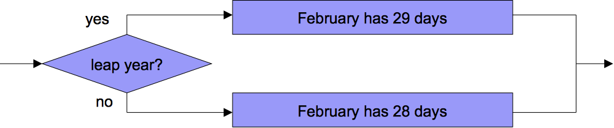
Control structures: Decision
Decision structures are a kind of control structure that allow the program to execute different sequences of instructions for different cases
  program can “choose” a course of action
  e.g. if it is a leap year then there are 29 days in February, otherwise there are 28
Notes:
#note on some forms of parrallel computing – works almost netirel on decision strucutres

Slide 4



If
The if statement can perform a simple test:
<condition> true?
yes
<statement>
no
<statement>
  if a < b:
  print "Computer says Yes”
  if (stockPrice<100):
  print(“Sell!”)
<statement>

Slide 5
Relational operators
simple conditions compare the values of two expressions:
<expr> <relop> <expr>
There are six relational operators in Python:
Python | Mathematics | Meaning
< | < | less than
> | > | greater than
<= | ≤ | less than or equal to
>= | ≥ | greater than or equal to
== | = | equal to
!= | ≠ | not equal to
Notes:
Note = versus == - same in Java and C/C++
common mistake using = instead of ==

Slide 6


If/else –
Two-way decisions
No
Yes
<condition> true?
<statement>
<statement>
Notes:
Meant to be talking about control next week, but you need it now!

Slide 7
If/else –
Two-way decisions
    if a < b:
    print "Computer says Yes"
    else:
    print "Computer says No”
    if (raining==True):
    luggage=“Raincoat”
    else:
    luggage=“Sunhat”
The else clause is optional.
Notes:
Meant to be talking about control next week, but you need it now!

Slide 8
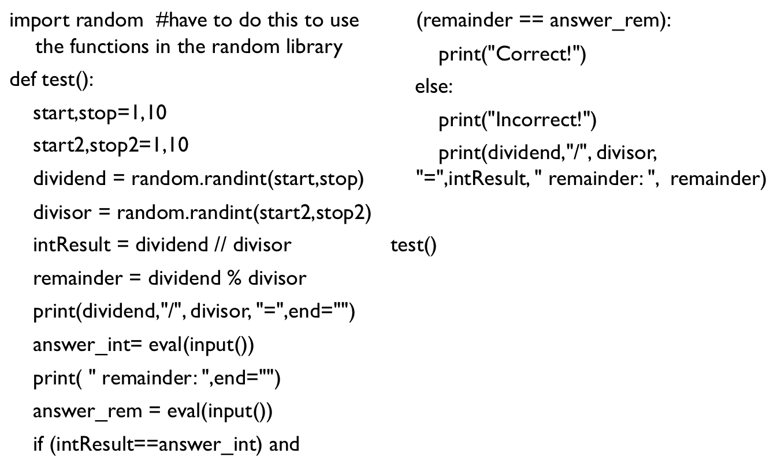
If/else improvement to Kiddymaths

Slide 9
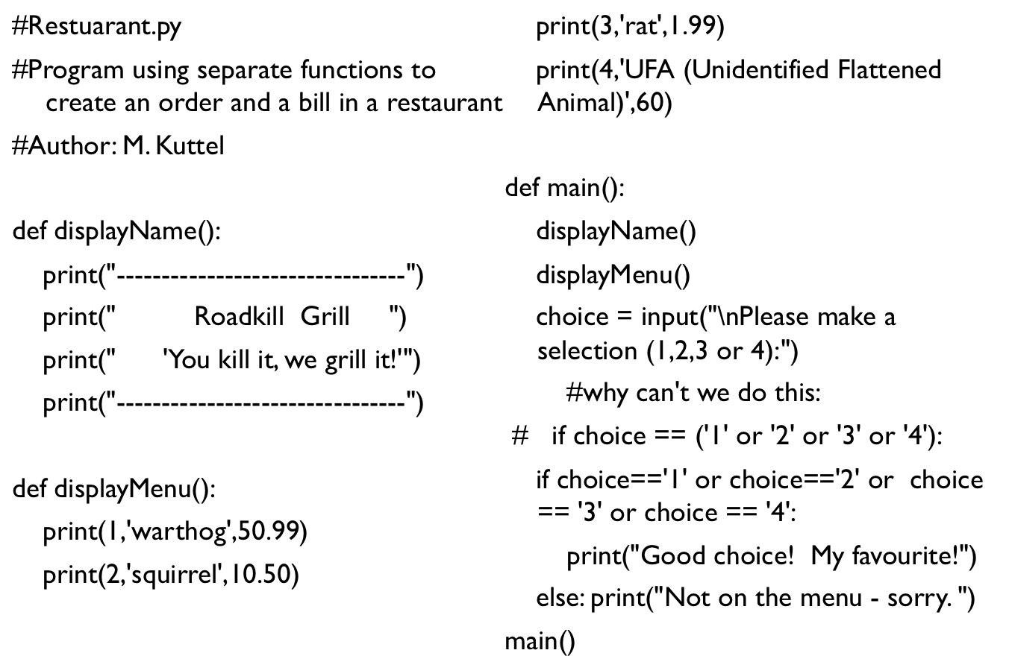
Restaurant example

Slide 10
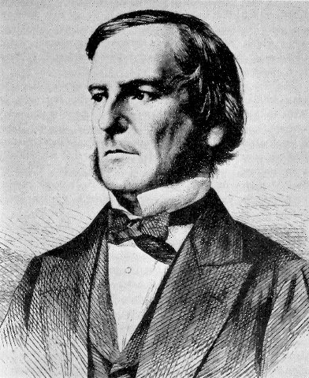
Boolean expressions
Conditions are actually a type of Boolean Expression
    Boolean expressions evaluate to true or false
      named after George Boole, 19th Century English mathematician
    Some languages use 0 or 1
    Others have a data type
    Python has literals True and False
  example Boolean Expressions
    3<4
    “anna”==“anna”

Slide 11
Boolean type
Boolean is a built-in type from Python 2.3 onwards:
  Has values of True or False
    if x>y:
    greater_x = True
    else:
    greater_x = False

Slide 12
Boolean expressions and relational operators
Comparison operators (==, >, <, >=, <=, !=) return True or False:
    >>> type('a')==str
    True
    >>> type('a')==int
    False

Slide 13
Boolean expressions and logical operators
  Logical operators (and, or, not) can combine Boolean expressions:
  if raining and not raincoat:
  wet=True
  if well and rich and Saturday:
  party=True

Slide 14
Write a program to work out whether a student gets DP
From the “Notes to Students”:
A student is granted Duly Performed (DP) status (and may write the exam) in CSC1015F if the following condition is met:
• (3/5 * Practicals average + 2/5 * Practical test average ) >= 45%

Slide 15
Write a program to work out whether a student gets DP
Write down the algorithm in pseudocode…
Then write down the Python program
Notes:
Note: sensible approach to writing programs

Slide 16
Note: and works like *, or like +
a and b or c
is the same as
(a and b) or c
and not the same as
a and (b or c)
Rules of Precedence:
  Same as in Mathematics
  PEMDAS - parentheses, exponentiation, multiplication/division, addition/subtraction
  If in doubt, add parentheses
if in doubt,
use brackets

Slide 17
Boolean expressions and logical operators
NOTE: Python allows (0 < x < 10) instead of (x > 0 and x < 10)
It it not in the syllabus, but it will help to look up Boolean Algebra and the useful De Morgan’s Laws:
not (A or B) == (not A) and (not B)
not (A and B) == (not A) or (not B)
  if (monster or badGuy) \
  and (moneyinWallet>100) \
  and not (weapon or friends) :
  print(“Run!!”)

Slide 18
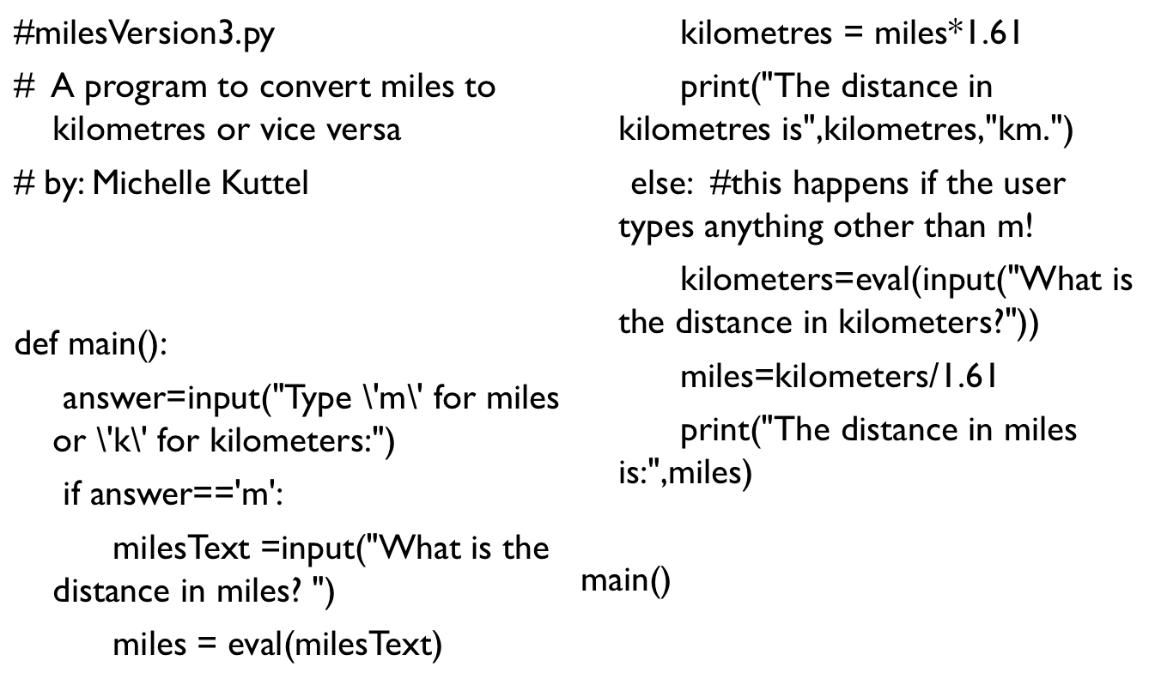
Example: milesVersion3.py

Slide 19
Example: milesVersion3.py
but this would work better with another “nested” condition…

Slide 20
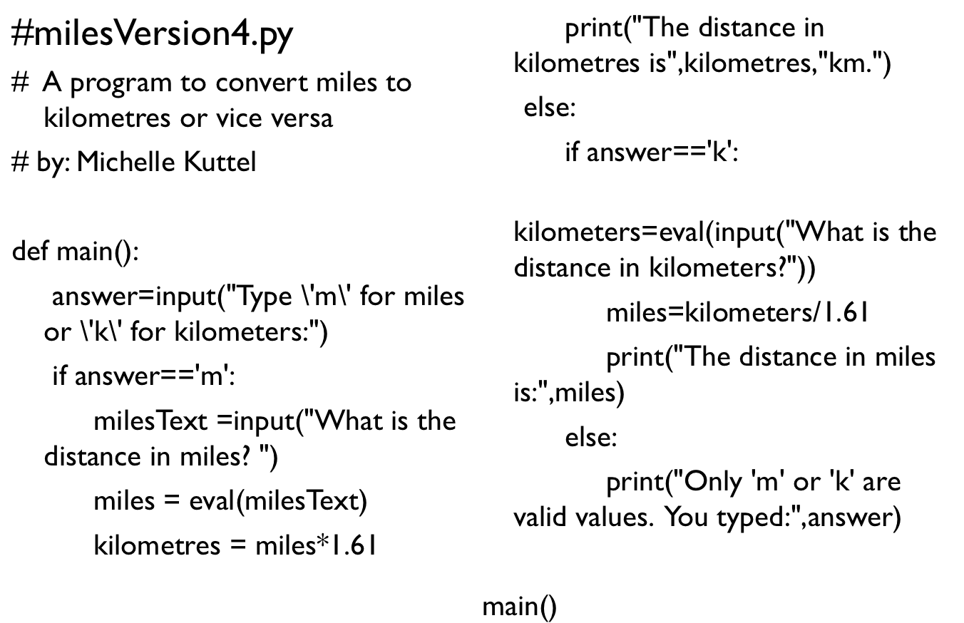
milesVersion4.py

Slide 21

If “ladder” program
Write a program to allocate a grade to an exam mark
Grade Allocation
1 = 75-100; 2+ = 70-74; 2- = 60-69; 3 = 50-59; F = 0-49

Slide 22
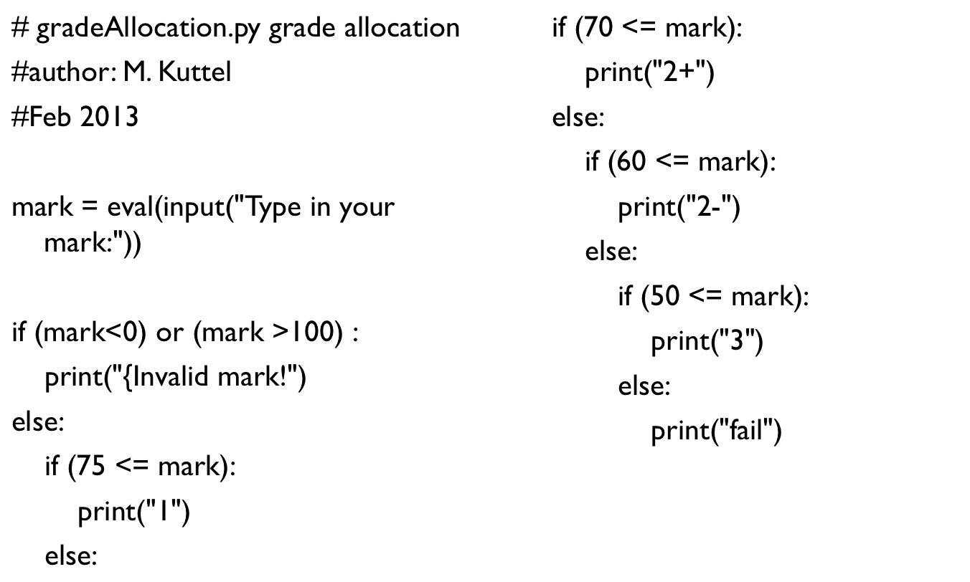

Slide 23
elif shortcut
To handle multiple-test cases, use elif:
    if suffix == ".htm":
    content = "text/html"
    elif suffix == ".jpg":
    content = "image/jpeg"
    elif suffix == ".png":
    content = "image/png"
    else:
    print("Unknown content type")
Notes:
Python does not have a special switch or case statement for testing values.

Slide 24
Grade allocation with elif:

Slide 25
Homework
Write a program that is given a person’s age and classifies them into baby, child, teenager, adult, pensioner.
Your program should also give an appropriate response for values out of the range.

Slide 26
More about the Boolean type
  Actually a subtype of integer, True = 1, False = 0 and behave accordingly, except when converted to string
    0, '', [], (), {}, None are considered False
    everything else is True

Slide 27
Checkpoint (from Restaurant.py)
  choice = input("\nPlease make a selection (1,2,3 or 4):")
  #why can't we do this?:
  # if choice == ('1' or '2' or '3' or '4'):

Slide 28
Checkpoint
What is the exact output of the following (strange) code?
def op1(a,b,c):
if (a>b) and (b>c):
print("in a row!")
elif (a>b) or (b>c):
print("some in order")
elif a:
print("first ok")
else: print("mixup!”)
op1(2,1,0)
op1(0,1,2)
op1(1,2,0)
op1(1,1,1)

Slide 29
Pizza program
Write a program to determine the toppings on a pizza based on the menu number.
  Margarita: cheese and tomato
  Vegetarian: cheese, tomato, asparagus, spinach, olives, onion
  Greek: cheese, tomato, olives, spinach
  Rugby: cheese, tomato, biltong, naartjie segments

Slide 30
Multiway if/else example: Final Course Mark
Write a program to calculate your final grade and symbol in CSC1015F based on marks for theory tests, exam, practicals and practical tests.
  This must include the possibility of DPR.
A final mark in CSC1015F will be calculated as follows:
Final = 0.15 * Practical average + 0.15 * Test average+ 0.10 * Practical test average + 0.60 * Exam
In order to pass, ALL of the following requirements MUST be met:
  · Final >= 50%
  · (3/5 * Practical average + 2/5 * Practical test average ) >= 45%
  · (1/5 * Test average + 4/5 * Exam) >= 45%

Slide 31
Multiway if/else example: Final Course Mark
Write down the algorithm in pseudocode…
Then write down the Python program
CourseMark.py

Slide 32
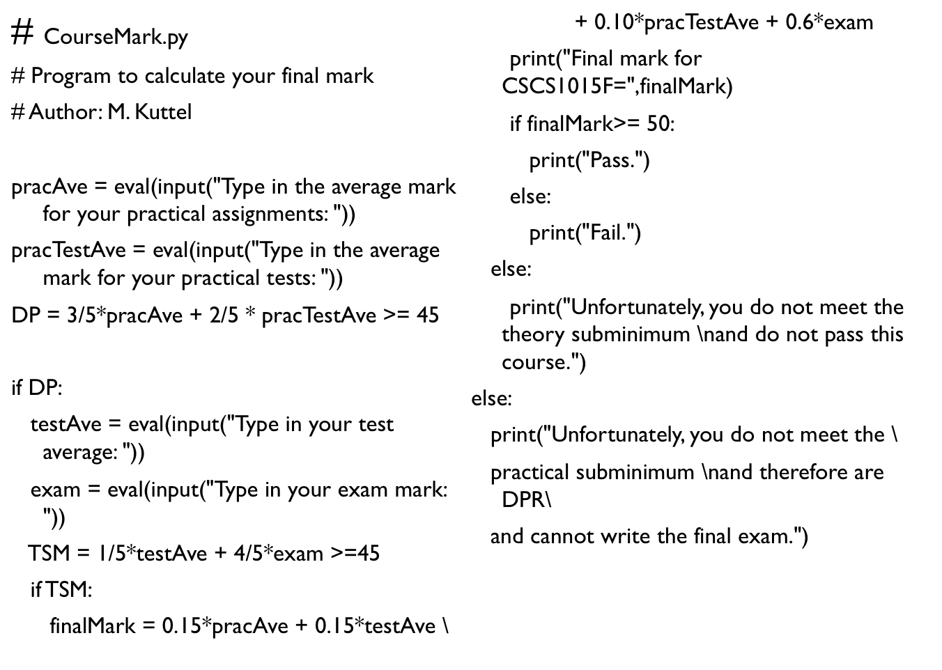

Slide 33
Example: conditional program execution
Some Python module files are designed to be run directly
  usually referred to as “programs” or “scripts”
Others are designed to be primarily imported and used by other programs
  usually referred to as “libraries”
Sometimes we want both functionalities, a module that can be either imported or run directly (when the “main” function will execute)

Slide 34
Example: conditional program execution
A module can determine how it is being run by looking at the value of the __name__ variable
if it is imported, __name__ will be the name of the module (e.g. ‘math’ for math.py)
if it is being run directly, __name__ will have the value ‘__main__’
So, you can do this to ensure that a module is run when it is invoked directly, but NOT if it is imported
if __name__ == ‘__main__’:
main()
Notes:
crossover example

Slide 35
Hello World with conditional program execution
HW.py

Slide 36

More explanation of conditional program execution
Imagine that you have a Python computer game
called SlimeMonsterBlood3
You can either
run this as a game (execute it)
Or else import it as a module when creating another game (FairyCastlePrincess)
  In this case, you would use the functions in SlimeMonsterBlood3 (castSpell, fightMonster, getAmmunition) as building blocks for your new game

Slide 37
Explaining Conditional program execution
You understand this, right? -
if x == True:
monsterBloodThree()

Slide 38
Explaining Conditional program execution
and this, right? -
if x == “Run”:
monsterBloodThree()

Slide 39
Explaining Conditional program execution
Now, __name__ is just another variable …
if __name__ == “Run”:
main()

Slide 40
Explaining Conditional program execution
And __main__ is just another literal …
if __name__ == ‘__main__’:
main()

Slide 41
To read in Chapter 7
Study in Design: Minimum of 3
Write an algorithm to calculate the minimum of 3 integers without using the Math methods, min or max (or loops!).
  Use a sequence of if statements.
Now do the minimum of 5 with the same algorithm
Notes:
Strategy 1: compare each to all
Strategy 2: decision tree
Strategy 3: sequential processing, with max variable
Strategy 4: Use Python’s min function

Slide 42
Lessons learnt:
There is more than one algorithm to solve this problem
Be the computer
Write a general solution
Don’t reinvent the wheel

Slide 43
Problem example
Write a program to sort 3 integers and output the sorted order symbolically.
You CAN”T use the sort() function
For example, if the numbers are {a=3, b=6, c=5}, then the sorted order is “a c b”.
Use nested if statements
Notes:
For interest: How many comparisons will this algorithm make in the best case, worst case and average case?

Slide 44
Decision tree for sorting 3 elements with comparisons
Notes:
For interest: How many comparisons will this algorithm make in the best case, worst case and average case?

